Slide 1
Morphology and Finite-State Transducers

Slide 2
The problem of recognizing that foxes breaks down into the two morphemes
fox and -es is called morphological parsing.
Similar problem in the information retrieval domain: stemming
Given the surface or input form going, we might want to produce the parsed form: VERB-go + GERUND-ing
In this chapter
– morphological knowledge and
– The finite-state transducer
It is quite inefficient to list all forms of noun and verb in the dictionary because the productivity of the forms.
• Morphological parsing is necessary more than just IR, but also
– Machine translation
– Spelling checking

Slide 3
Morphemes
Morphology is the study of the way words are built up from smaller meaning-bearing units, morphemes.
Two broad classes of morphemes: –
- The stems: the “main” morpheme of the word, supplying the main meaning,
-while – The affixes: add “additional” meaning of various kinds.
Affixes are further divided into prefixes, suffixes, infixes, and circumfixes. – Suffix: eat-s – Prefix: un-buckle

Slide 4

Free Morphemes
Lexical and grammatical Morphemes
Lexical Morphemes: Independent words (Noun, Verb, adjectives, adverbs)
Grammatical Morphemes: and, or
Bound Morphemes
Inflectional Morphemes
Derivation Morphemes

Slide 5
Prefixes and suffixes are often called concatenative morphology.
A number of languages have extensive non-concatenative morphology.
Two broad classes of ways to form words from morphemes: – Inflection: the combination of a word stem with a grammatical morpheme, usually resulting in a word of the same class as the original term, and usually filling some syntactic function like agreement, and – Derivation: the combination of a word stem with a grammatical morpheme, usually resulting in a word of a different class, often with a meaning hard to predict exactly.

Slide 6
Morphological parsing
Breaking down words into components and building a structured representation.
English:
● cats = cat +N +Pl
●caught =catch +V +Past

Slide 7
Inflection Morphology
In English, only nouns, verbs, and sometimes adjectives can be inflected, and the number of affixes is quite small.
• Inflections of nouns in English: – An affix marking plural,
• cat(-s),
thrush(-es),
ox (oxen),
mouse (mice)
box(-es),
butterfly(-lies)

Slide 8
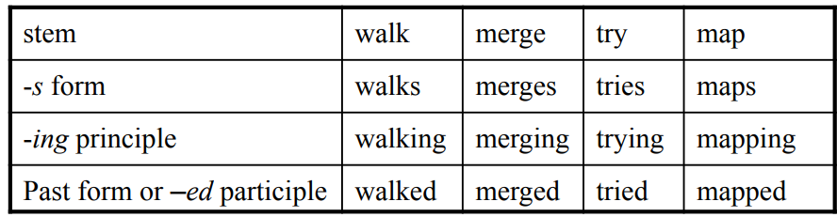
Verbal inflection is more complicated than nominal inflection. – English has three kinds of verbs:
Main verbs, eat, sleep
Modal verbs, can will, should
Primary verbs, be, have, do
– Morphological forms of regular verbs
These regular verbs and forms are significant in the morphology of English because of their majority and being productive.

Slide 9
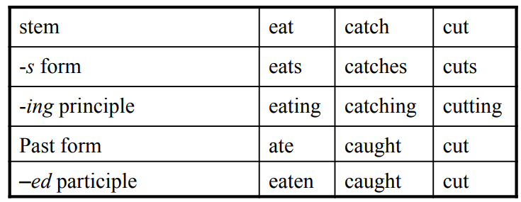
Morphological forms of irregular verbs

Slide 10
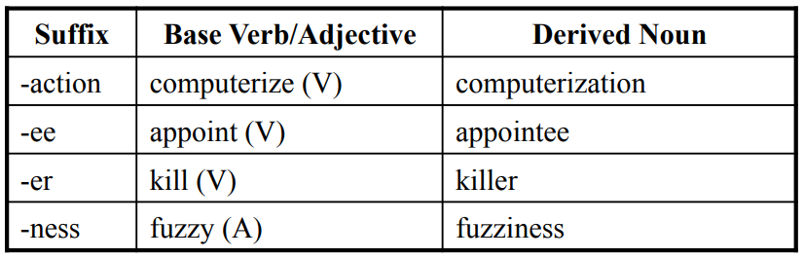
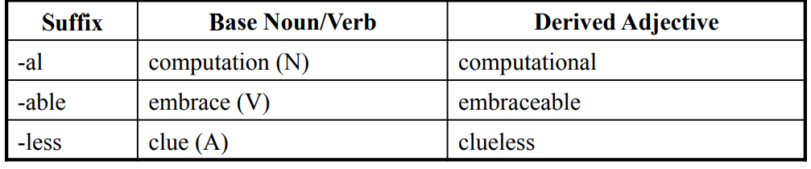
Derivational Morphology
Nominalization in English: – The formation of new nouns, often from verbs or adjectives
Adjectives derived from nouns or verbs

Slide 11
Derivational Morphology
Derivation in English is more complex than inflection because – Generally less productive
• A nominalizing affix like –ation can not be added to absolutely every verb. eatation(*) – There are subtle and complex meaning differences among nominalizing suffixes.
For example, sincerity has a subtle difference in meaning from sincereness.

Slide 12
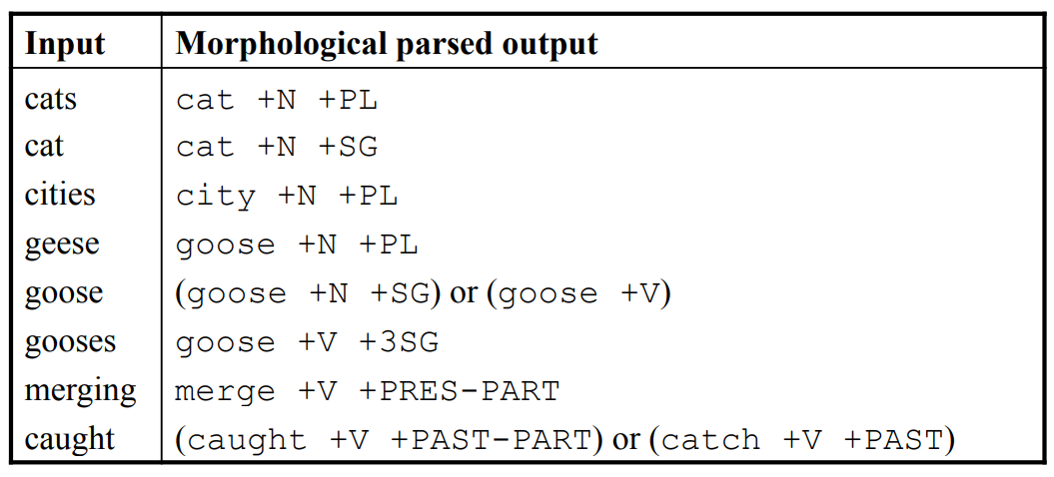
Finite-State Morphological Parsing
Parsing English morphology

Slide 13
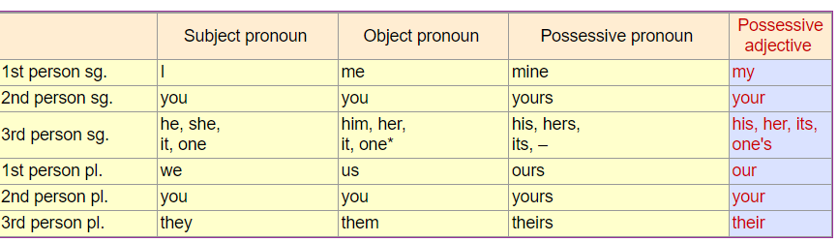

Slide 14
Finite-State Morphological Parsing
We need at least the following to build a morphological parser:
Lexicon: the list of stems and affixes, together with basic information about them (Noun stem or Verb stem, etc.)
Morphotactics: the model of morpheme ordering that explains which classes of morphemes can follow other classes of morphemes inside a word. E.g., the rule that English plural morpheme follows the noun rather than preceding it.
Orthographic rules: these spelling rules are used to model the changes that occur in a word, usually when two morphemes combine (e.g., the y→ie spelling rule changes city + -s to cities)

Slide 15

Surface segmentation: sequence of substrings whose concatenation is the entire word
– achievability = achiev + abil + ity
Canonical segmentation: sequence of standardized segments
– achievability = achieve + able + ity

Slide 16

Stemming vs. Lemmatization
Stemming: stripping off word endings (rule-based)
– foxes = fox
– going =go
Lemmatization: mapping the word to its lemma (lexicon-based)
– sang, sung = sing
– going, went, goes = go

Slide 17
Motivation for morphological parsing
Information retrieval – Normalize verb tenses, plurals, grammar cases ● Machine translation – Translation based on the stem

Slide 18
Morphological parsing
Resources
– Lexicon
● List of all stems and affixes
– Morphotactics
– Ortographic rules

Slide 19
Resources
– Lexicon
– Morphotactics
● A model of morpheme ordering in a word
● e.g., plurals are suffixes in English
– Ortographic rules

Slide 20
Resources
– Lexicon
– Morphotactics
– Ortographic rules
● Rules for changing in the words when combining morphemes
● e.g., city = cities

Slide 21
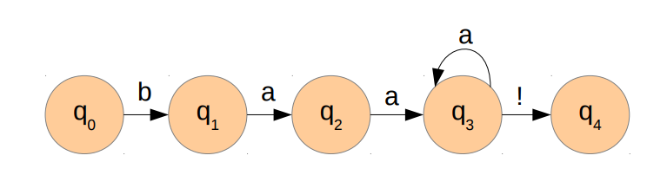
Finite-state automata (FSA)
FSAs are composed of
– Vertices (nodes)
– Arcs (links)
string?

Slide 22
Finite-State Morphological Parsing The Lexicon and Morphotactics
A lexicon is a repository for words.
– The simplest one would consist of an explicit list of every word of the language. Inconvenient or impossible!
– Computational lexicons are usually structured with
• a list of each of the stems and
• Affixes of the language together with a representation of morphotactics telling us how they can fit together.
– The most common way of modeling morphotactics is the finite-state automaton

Slide 23
Finite State Automata
A model of computation that takes in some input string, processes them one symbol at a time, and either accepts or rejects the string.
e.g., we write a FSA to accept only valid English words.
A particular FSA defines a language (a set of strings that it would accept).
e.g., the language in the FSA we are writing is the set of strings that are valid English words.
Regular languages are languages that can be described by an FSA (i.e., the FSA accepts exactly those strings that are in the language)

Slide 24
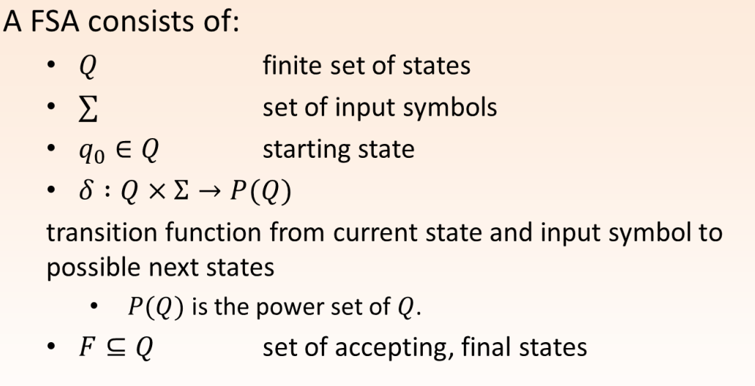

Slide 25
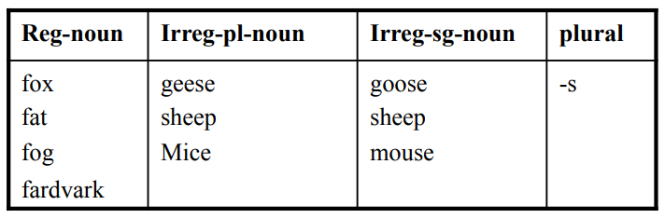
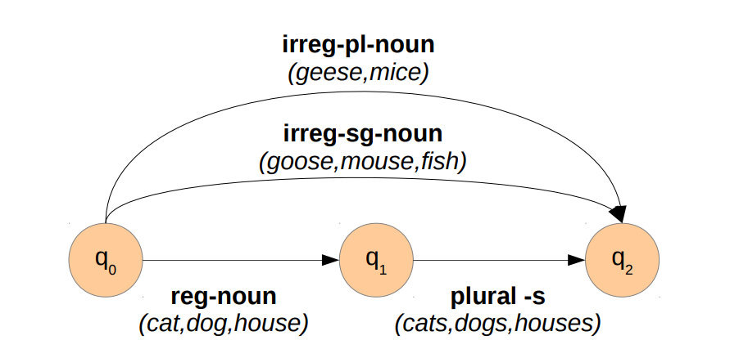

Finite-state lexicon
Finite state automata (FSA) for English nominal inflection (same word category)

Slide 26
English derivational morphology is more complex than English inflectional morphology, and so automata of modeling English derivation tends to be quite complex.
– Some even based on CFG
• A small part of morphosyntactics of English adjectives

Slide 27
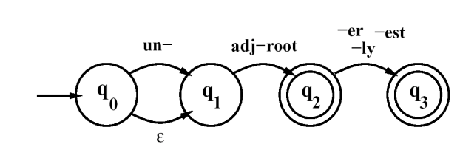
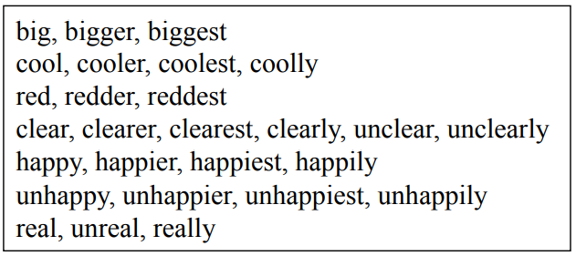
FSA for derivational morphology (distinct word categories)
An FSA for a fragment of English adjective Morphology #1

Slide 28
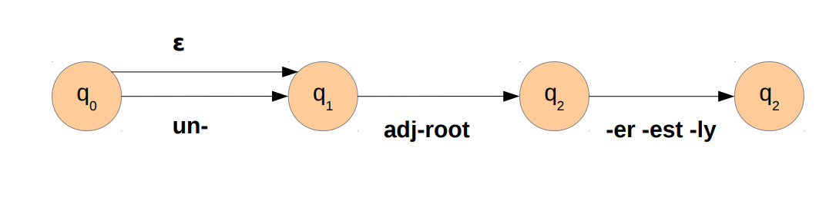
Exercise: Is it possible to create adjectives that do not exist?

Slide 29
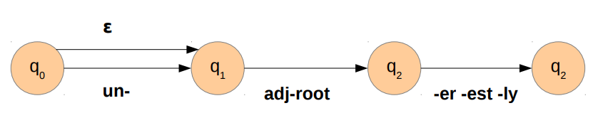
Exercise: Is it possible to create adjectives that do not exist?
Incorrect adjectives:
- un-small-er
- orange-er
- small-ly
Solution: classes of roots (adj-root 1 , adj-root 2 , etc.)

Slide 30
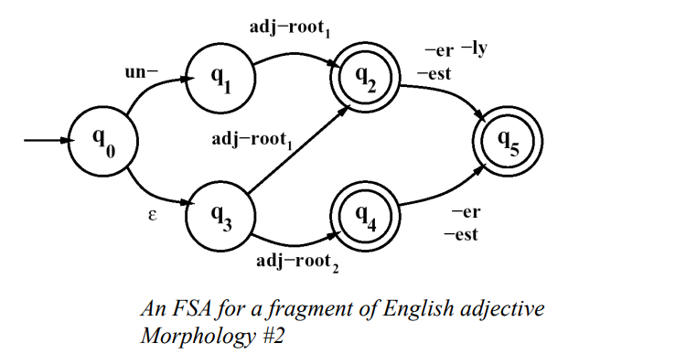
Finite-State Morphological Parsing
The FSA#1 recognizes all the listed adjectives, and ungrammatical forms like unbig, redly, and realest.
Thus #1 is revised to become #2.
The complexity is expected from English derivation.

Slide 31
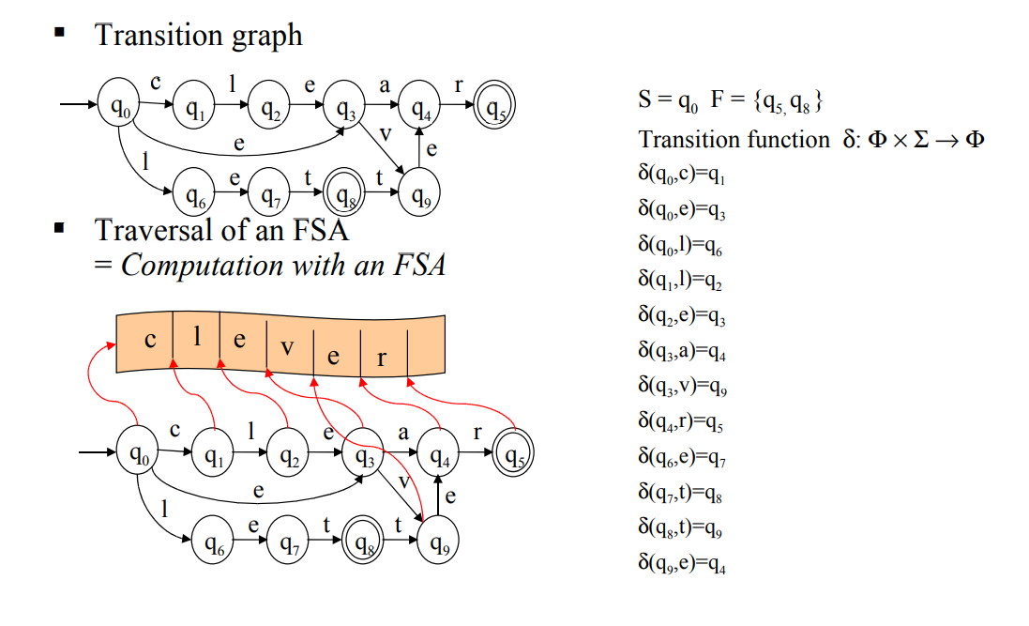

Slide 32
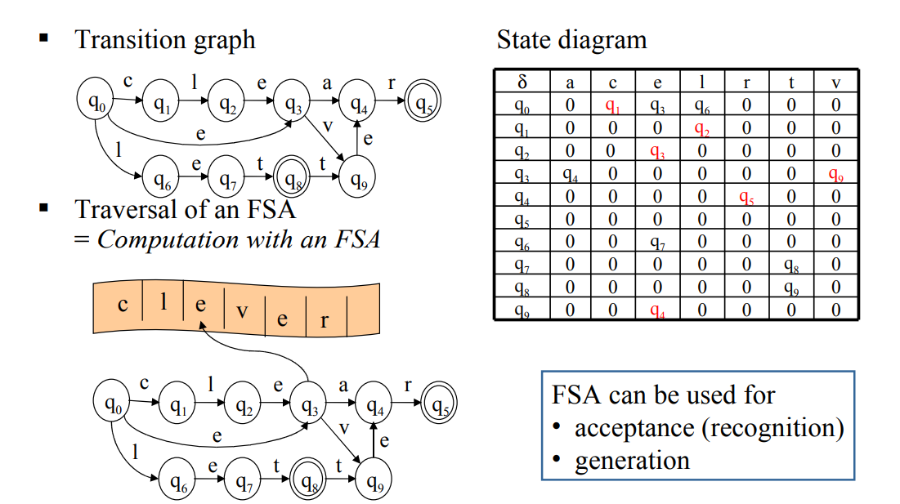

Slide 33
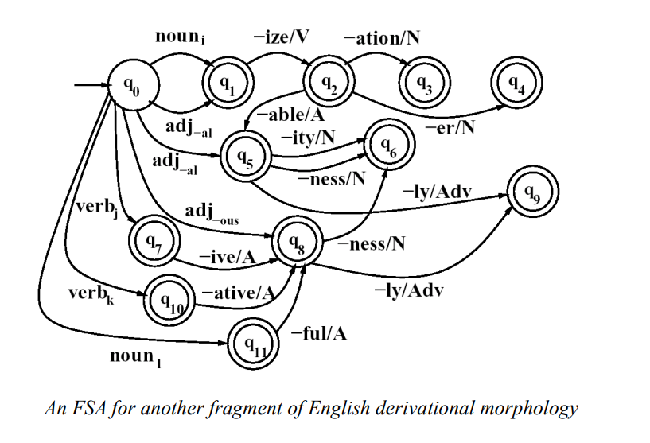

Finite-State Morphological Parsing

Slide 34
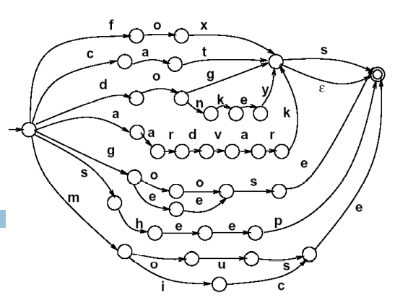
We can now use these FSAs to solve the problem of morphological recognition:
– Determining whether an input string of letters makes up a legitimate English word or not
– We do this by taking the morphotactic FSAs, and plugging in each “sub-lexicon” into the FSA.
– The resulting FSA can then be defined as the level of the individual letter.

Slide 35
Applications of FSA: String Matching
Substring matching
– Identify stop words in stream of text
– Stem recognition: small, smaller, smallest
Make use of full power of finite-state operations! – Regular expression with any-symbols for text search
small( ε | er | est) , ( a | the | …)
– Compilation to NFSA, convert to DFSA – Application by composition of FST with full text
FSAtext stream FSTsmall : if defined, search term is substring of text

Slide 36
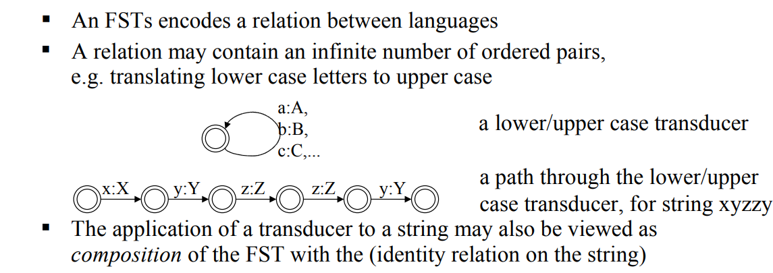
Finite State Transducer

Slide 37
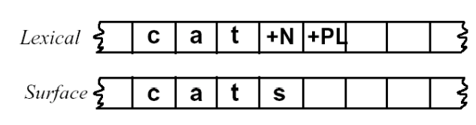
Finite-State Morphological Parsing Morphological Parsing with FST
Given the input, for example, cats, we would like to produce cat +N +PL.
Two-level morphology, by Koskenniemi (1983)
– Representing a word as a correspondence between a lexical level
• Representing a simple concatenation of morphemes making up a word, and
– The surface level
• Representing the actual spelling of the final word.
• Morphological parsing is implemented by building mapping rules that maps letter sequences like cats on the surface level into morpheme and features sequence like cat +N +PL on the lexical level

Slide 38
Finite-State Morphological Parsing Morphological Parsing with FST
The automaton we use for performing the mapping between these two levels is the finite-state transducer or FST.
– A transducer maps between one set of symbols and another;
– An FST does this via a finite automaton.
Thus an FST can be seen as a two-tape automaton which recognizes or generates pairs of strings.
The FST has a more general function than an FSA:
– An FSA defines a formal language
– An FST defines a relation between sets of strings.
Another view of an FST:
– A machine reads one string and generates another.

Slide 39
Recognition vs Parsing
Morphological recognition
is_pasttense_verb(loved) --> TRUE
Finite State Automata can do this
• Morphological parsing: what is its breakdown?
parse(loved) --> take/VERB -n/PAST-TENSE • Finite State Transducers can do this

Slide 40
Finite State Transducer
FSAutomata
• An FSA represents a set of strings. e.g. {walk, walks, walked, love loves, loved}
• Regular language.
• A recognizer function. recognize(str) -> true or false
• FSTransducers
• An FST represents a set of pairs of strings (think of as input,output pairs) { (walk, walk+V+PL), (walk, walk+N+SG), (walked, walk+V+PAST) ...}
• A transducer function: maps input to zero or more outputs.
transduce(walk) --> {walk+V+PL, walk+N+SG} Can return multiple answers if ambiguity: e.g. if you don’t have POS-tagged input, “walk” could be the verb “They walk to the store” versus the noun “I took a walk”.
• Generic inversion and composition operations.

Slide 41
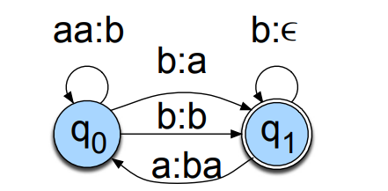
Finite State Transducer
FSAutomata have input labels.
One input tape
FSTransducers have input:output pairs on labels.
Two tapes: input and output.

Slide 42
FST as recognizer:
– a transducer that takes a pair of strings as input and output accept if the string-pair is in the string-pair language, and a reject if it is not.
• FST as generator:
– a machine that outputs pairs of strings of the language. Thus the output is a yes or no, and a pair of output strings.
• FST as transducer:
– A machine that reads a string and outputs another string.
• FST as set relater:
– A machine that computes relation between sets.

Slide 43
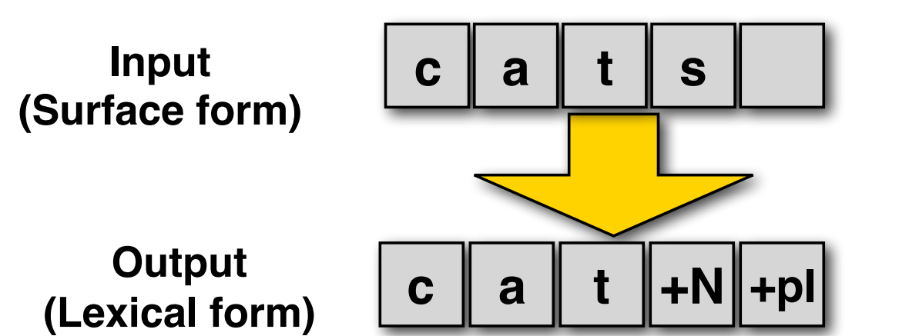
Recognition vs. Analysis
FSAs can recognize (accept) a string, but they don’t tell us its internal structure.
We need is a machine that maps (transduces) the input string into an output string that encodes its structure:

Slide 44
Finite-state transducers
An FST T = Lin ⨉ Lout defines a relation between two regular languages Lin and Lout:
Lin = {cat, cats, fox, foxes, ...}
Lout = {cat+N+sg, cat+N+pl, fox+N+sg, fox+N+pl ...}
T = { ⟨cat, cat+N+sg⟩, ⟨cats, cat+N+pl⟩, ⟨fox, fox+N+sg⟩, ⟨foxes, fox+N+pl⟩ }

Slide 45
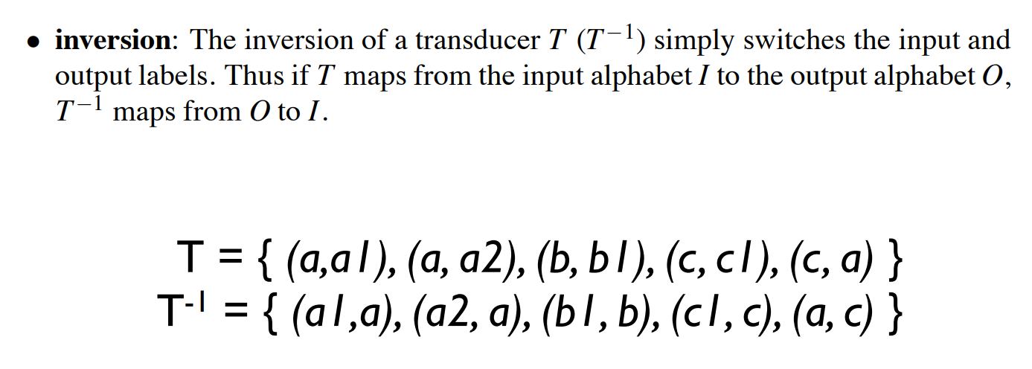
Some FST operations

Slide 46
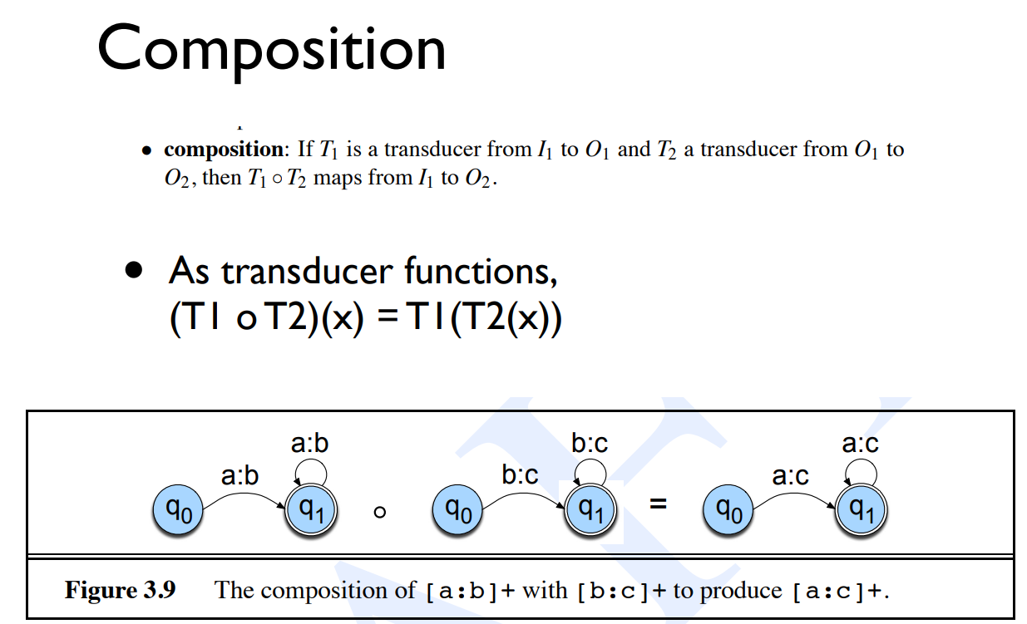

Slide 47
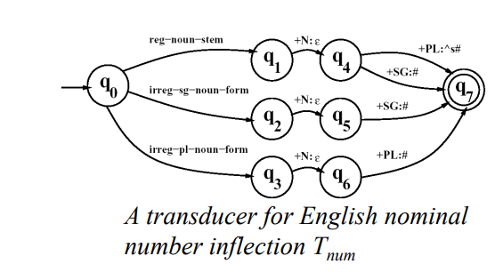
Inversion is useful because it makes it easy to convert a FST-as-parser into an FST as-generator.
• Composition is useful because it allows us to take two transducers than run in series and replace them with one complex transducer.
– T1。T2(S) = T2(T1(S) )

Slide 48
English spelling rules Peculiarities of English spelling (orthography)
The same underlying morpheme (e.g. plural-s) can have different orthographic “surface realizations” (-s, -es)
This leads to spelling changes at morpheme boundaries:
E-insertion: fox +s = foxes
E-deletion: make +ing = making

Slide 49
Intermediate representations
English plural -s: cat ⇒ cats dog ⇒ dogs but: fox ⇒ foxes, bus ⇒ buses buzz ⇒ buzzes
We define an intermediate representation to capture morpheme boundaries (^) and word boundaries (#): Lexicon:
cat+N+PL, fox+N+PL
Intermediate representation: cat^s#, fox^s# Surface string: cats foxes Intermediate-to-Surface Spelling Rule: If plural ‘s’ follows a morpheme ending in ‘x’,‘z’ or ‘s’, insert ‘e’.

Slide 50
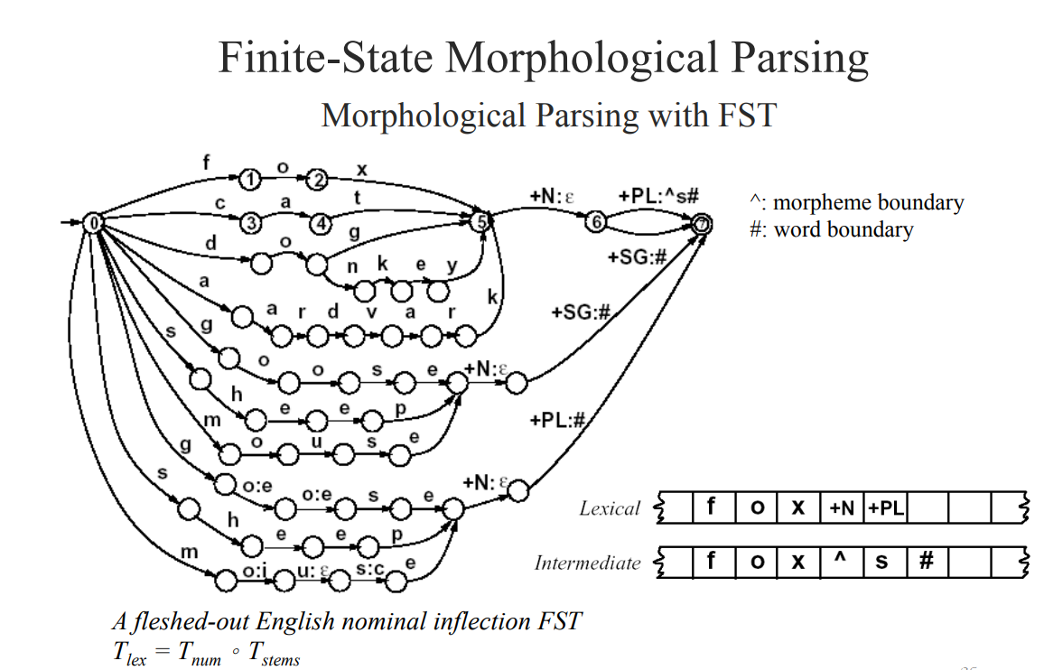

Slide 51
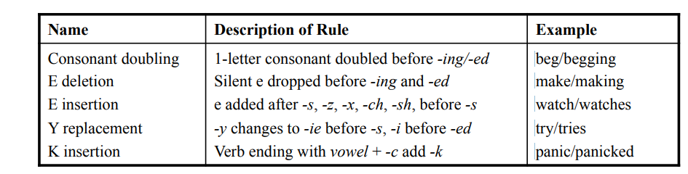
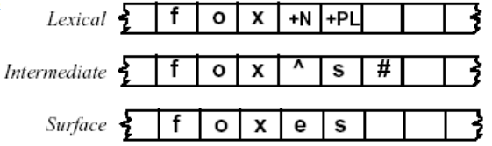
Finite-State Morphological Parsing Orthographic Rules and FSTs
Spelling rules (or orthographic rules) Name Description of Rule–
These spelling changes can be thought as taking as input a simple concatenation of morphemes and producing as output a slightly-modified concatenation of morph

Slide 52
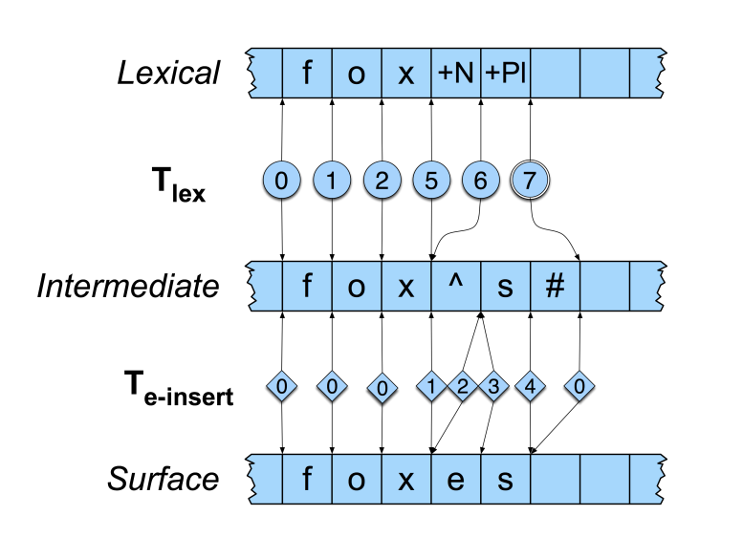
FST composition/cascade:

Slide 53
Deterministic Finite Automata
DFA refers to deterministic finite automata. Deterministic refers to the uniqueness of the computation. The finite automata are called deterministic finite automata if the machine is read an input string one symbol at a time.
In DFA, there is only one path for specific input from the current state to the next state.

Slide 54
A DFA is a collection of 5-tuples same as we described in the definition of FA.
Q: finite set of states
∑: finite set of the input symbol
q0: initial state
F: final state
δ: Transition function
Transition function can be defined as:δ: Q x ∑→Q

Slide 55
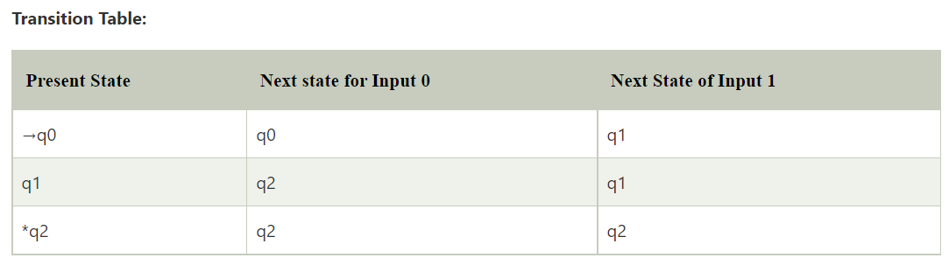
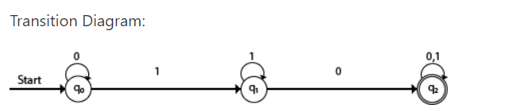
Q = {q0, q1, q2}
∑ = {0, 1}
q0 = {q0}
F = {q2}

Slide 56
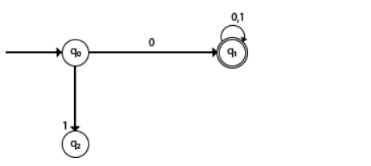
DFA with ∑ = {0, 1} accepts all starting with 0.
In the above diagram, we can see that on given 0 as input to DFA in state q0 the DFA changes state to q1 and always go to final state q1 on starting input 0. It can accept 00, 01, 000, 001....etc. It can't accept any string which starts with 1, because it will never go to final state on a string starting with 1.

Slide 57
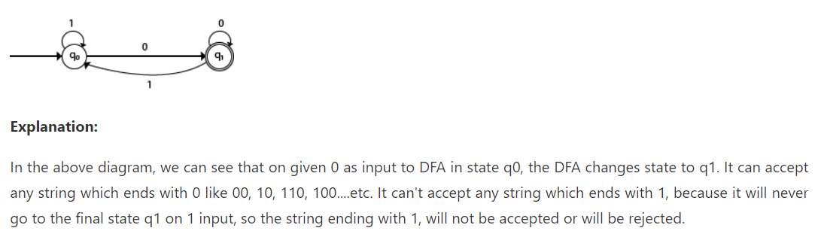
DFA with ∑ = {0, 1} accepts all ending with 0.

Slide 58
Design a FA with ∑ = {0, 1} accepts those string which starts with 1 and ends with 0.

Slide 59
Design a FA with ∑ = {0, 1} accepts the only input 101.

Slide 60
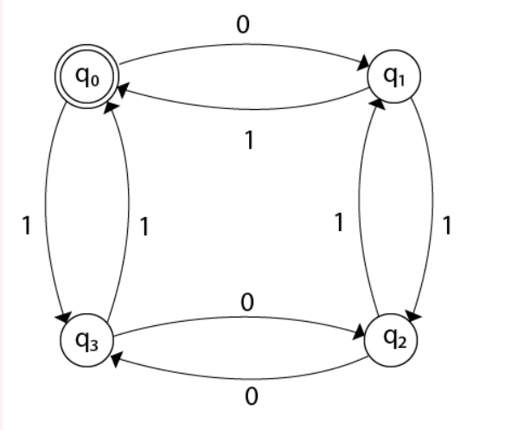
Design FA with ∑ = {0, 1} accepts even number of 0's and even number of 1’s.

Slide 61
Design FA with ∑ = {0, 1} accepts the set of all strings with three consecutive 0's.

Slide 62
Design a DFA L(M) = {w | w ε {0, 1}*} and W is a string that does not contain consecutive 1's.

Slide 63
Non Deterministic Finite Automata
NFA stands for non-deterministic finite automata. It is easy to construct an NFA than DFA for a given regular language.
The finite automata are called NFA when there exist many paths for specific input from the current state to the next state.
Every NFA is not DFA, but each NFA can be translated into DFA.
NFA is defined in the same way as DFA but with the following two exceptions, it contains multiple next states, and it contains ε transition.

Slide 64
NFA also has five states same as DFA, but with different transition function, as shown follows:
Q: finite set of states
∑: finite set of the input symbol
q0: initial state
F: final state
δ: Transition function
δ: Q x ∑ →2^{Q}

Slide 65
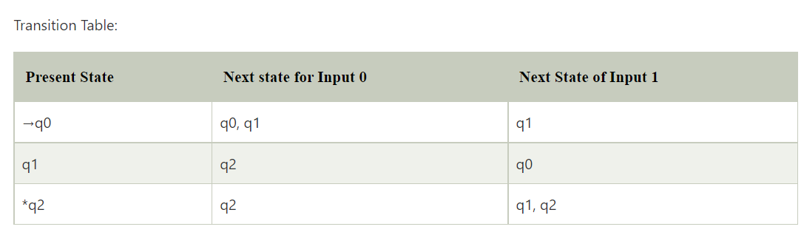
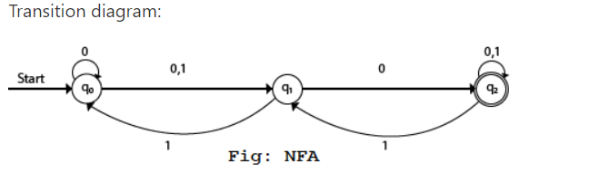
Q = {q0, q1, q2}
∑ = {0, 1}
q0 = {q0}
F = {q2}

Slide 66
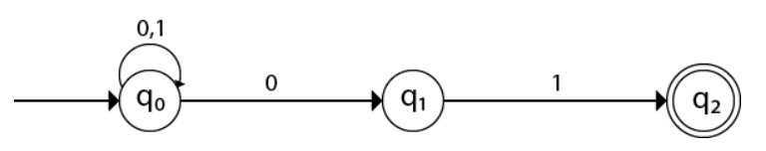
Design an NFA with ∑ = {0, 1} acepts all string ending with 01.

Slide 67
Design an NFA with ∑ = {0, 1} in which double '1' is followed by double '0'.

Slide 68
Design an NFA in which all the string contain a substring 1110.

Slide 69
Conversion of NFA to DFA
Steps for converting NFA to DFA:
Step 1: Initially Q' = ϕ
Step 2: Add q0 of NFA to Q'. Then find the transitions from this start state.
Step 3: In Q', find the possible set of states for each input symbol. If this set of states is not in Q', then add it to Q'.
Step 4: In DFA, the final state will be all the states which contain F(final states of NFA)

Slide 70
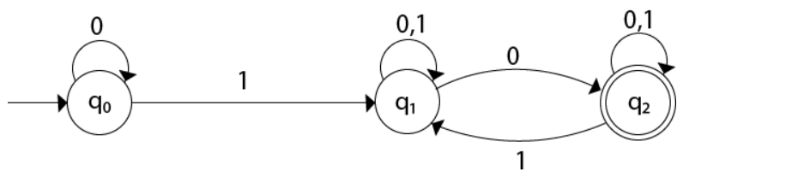
Convert the given NFA to DFA.
Now we will obtain δ' transition for state q0.
δ'([q0], 0) = [q0]
δ'([q0], 1) = [q1]
The δ' transition for state q1 is obtained as:
δ'([q1], 0) = [q1, q2] (new state generated)
δ'([q1], 1) = [q1]
The δ' transition for state q2 is obtained as:
δ'([q2], 0) = [q2]
δ'([q2], 1) = [q1, q2]
Now we will obtain δ' transition on [q1, q2].
State | 0 | 1
→q0 | q0 | q1
q1 | {q1, q2} | q1
*q2 | q2 | {q1, q2}

Slide 71
δ'([q1, q2], 0) = δ(q1, 0) ∪ δ(q2, 0)
= {q1, q2} ∪ {q2}
= [q1, q2]
δ'([q1, q2], 1) = δ(q1, 1) ∪ δ(q2, 1)
= {q1} ∪ {q1, q2}
= {q1, q2}
= [q1, q2]
The state [q1, q2] is the final state as well because it contains a final state q2. The transition table for the constructed DFA will be:

Slide 72
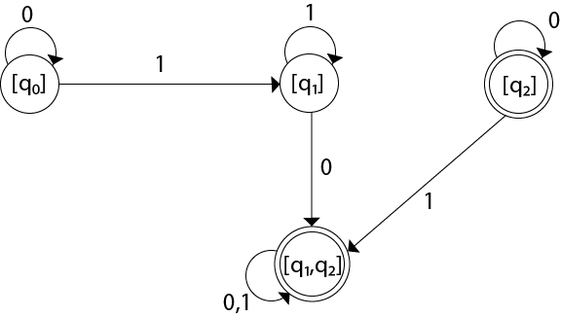
State | 0 | 1
→[q0] | [q0] | [q1]
[q1] | [q1, q2] | [q1]
*[q2] | [q2] | [q1, q2]
*[q1, q2] | [q1, q2] | [q1, q2]
The Transition diagram will be:
The state q2 can be eliminated because q2 is an unreachable state.

Slide 73
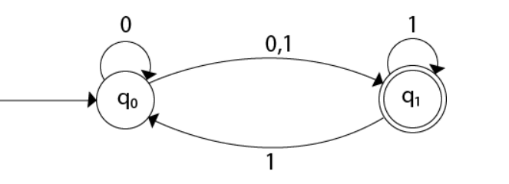
Convert the given NFA to DFA.

Slide 74
State | 0 | 1
→q0 | {q0, q1} | {q1}
*q1 | ϕ | {q0, q1}
Now we will obtain δ' transition for state q0.
δ'([q0], 0) = {q0, q1}
= [q0, q1] (new state generated)
δ'([q0], 1) = {q1} = [q1]
The δ' transition for state q1 is obtained as:
δ'([q1], 0) = ϕ
δ'([q1], 1) = [q0, q1]
Now we will obtain δ' transition on [q0, q1].
δ'([q0, q1], 0) = δ(q0, 0) ∪ δ(q1, 0)
= {q0, q1} ∪ ϕ
= {q0, q1}
= [q0, q1]
Similarly,
δ'([q0, q1], 1) = δ(q0, 1) ∪ δ(q1, 1)
= {q1} ∪ {q0, q1}
= {q0, q1}
= [q0, q1]

Slide 75
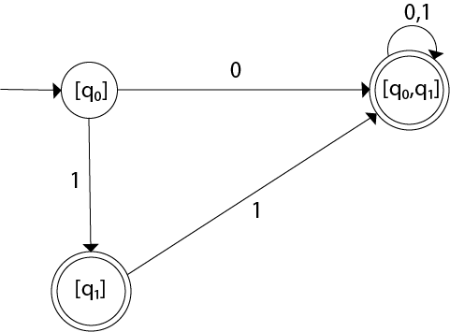
State | 0 | 1
→[q0] | [q0, q1] | [q1]
*[q1] | ϕ | [q0, q1]
*[q0, q1] | [q0, q1] | [q0, q1]
The Transition diagram will be:

Slide 76
Regular Expression
The language accepted by finite automata can be easily described by simple expressions called Regular Expressions. It is the most effective way to represent any language.
The languages accepted by some regular expression are referred to as Regular languages.
A regular expression can also be described as a sequence of pattern that defines a string.
Regular expressions are used to match character combinations in strings. String searching algorithm used this pattern to find the operations on a string.
For instance:
In a regular expression, x* means zero or more occurrence of x. It can generate {e, x, xx, xxx, xxxx, .....}
In a regular expression, x⁺ means one or more occurrence of x. It can generate {x, xx, xxx, xxxx, .....}

Slide 77
Operations on Regular Language
The various operations on regular language are:
Union: If L and M are two regular languages then their union L U M is also a union.
1. L U M = {s | s is in L or s is in M}
Intersection: If L and M are two regular languages then their intersection is also an intersection.
1. L ⋂ M = {st | s is in L and t is in M}
Kleen closure: If L is a regular language then its Kleen closure L1* will also be a regular language.
1. L* = Zero or more occurrence of language L.

Slide 78
Write the regular expression for the language accepting all combinations of a's, over the set ∑ = {a}
All combinations of a's means a may be zero, single, double and so on. If a is appearing zero times, that means a null string. That is we expect the set of {ε, a, aa, aaa, ....}. So we give a regular expression for this as:
R = a*

Slide 79
Write the regular expression for the language accepting all combinations of a's except the null string, over the set ∑ = {a}

Slide 80
The regular expression has to be built for the language
L = {a, aa, aaa, ....}
This set indicates that there is no null string. So we can denote regular expression as:
R = a⁺

Slide 81
Write the regular expression for the language accepting all the string containing any number of a's and b’s.

Slide 82
The regular expression will be:
r.e. = (a + b)*
This will give the set as L = {ε, a, aa, b, bb, ab, ba, aba, bab, .....}, any combination of a and b.
The (a + b)* shows any combination with a and b even a null string.

Slide 83
Write the regular expression for the language accepting all the string which are starting with 1 and ending with 0, over ∑ = {0, 1}.

Slide 84
In a regular expression, the first symbol should be 1, and the last symbol should be 0. The r.e. is as follows:
R = 1 (0+1)* 0

Slide 85
Write the regular expression for the language starting and ending with a and having any having any combination of b's in between.

Slide 86
Write the regular expression for the language starting with a but not having consecutive b's.

Slide 87
Describe the language denoted by following regular expression
r.e. = (b* (aaa)* b*)*

Slide 88
Write the regular expression for the language containing the string in which every 0 is immediately followed by 11.

Slide 89
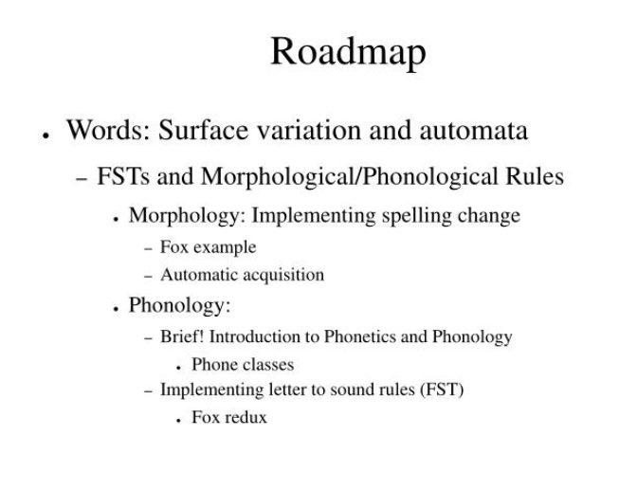

Slide 90
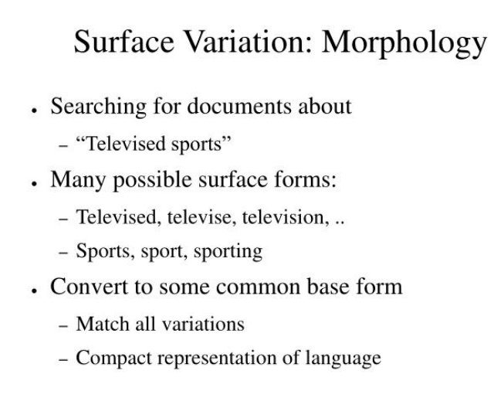

Slide 91
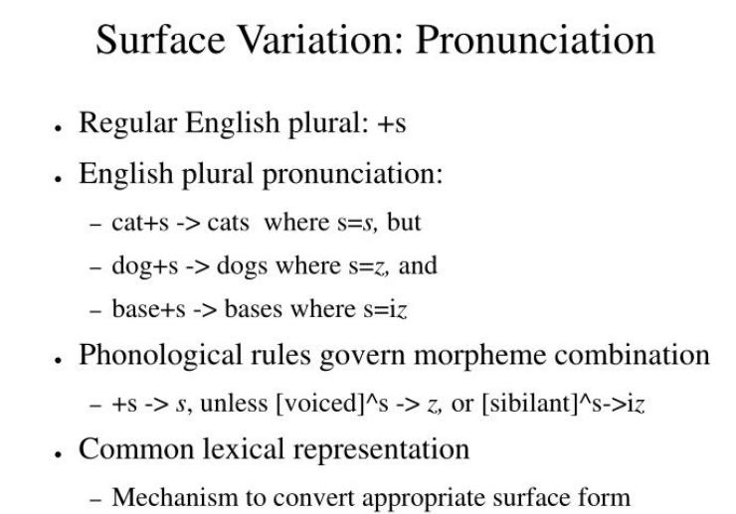

Slide 92
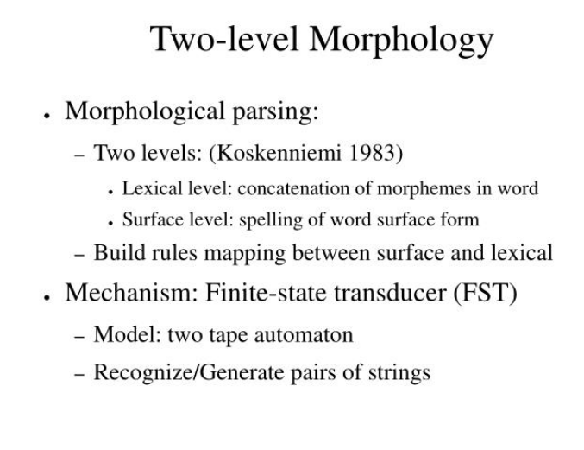

Slide 93
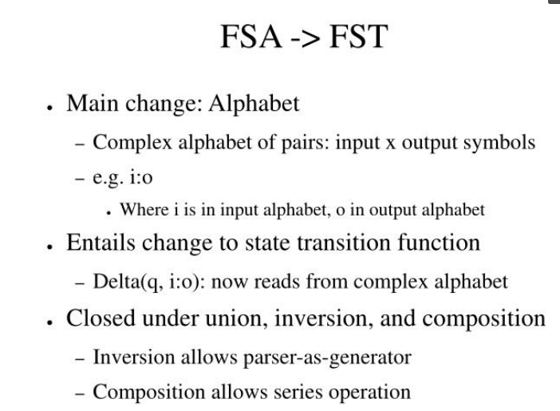

Slide 94
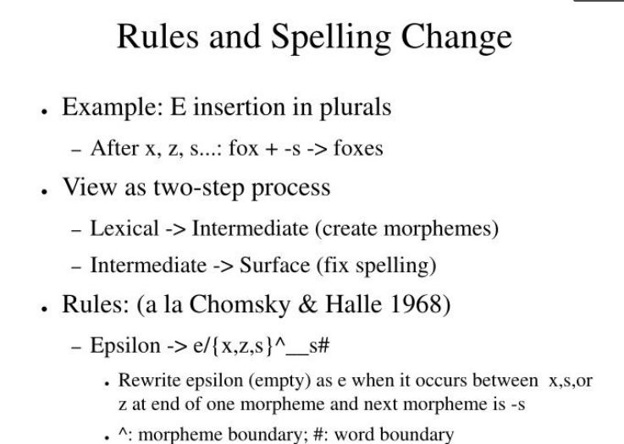

Slide 95
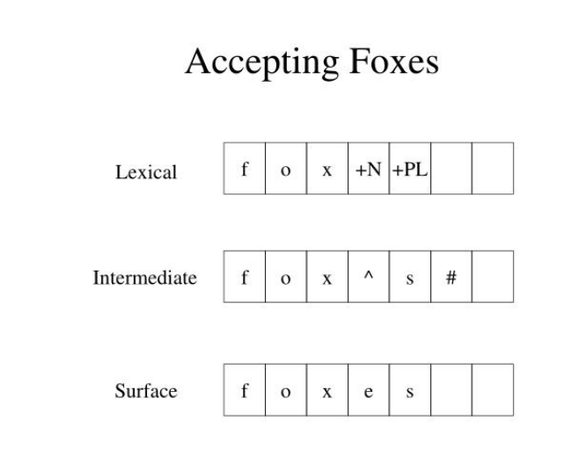

Slide 96
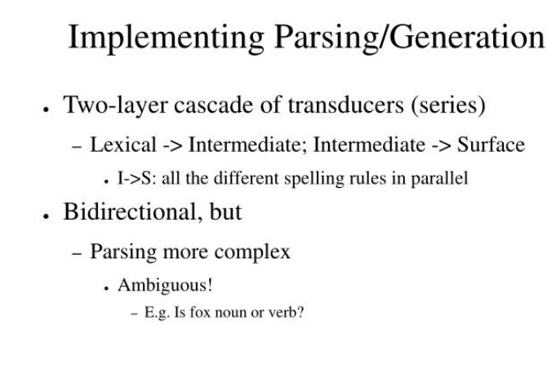

Slide 97


Slide 98
Other applications of FSTs
• Spelling correction: make an FST that can capture common mistakes
• Transpositions: teh -> the
• Speech recognition: phonemes, pronunciation dictionaries, words...
• OpenFST library: originally developed for speech applications • Machine translation: Model 1 can be thought of as an FST!
• Usually use weighted FSTs: probabilities of spelling errors, word/phrase translations, etc.

Slide 99
Lexicon-Free FSTs: the Porter Stemmer
Information retrieval
• One of the mostly widely used stemmming algorithms is the simple and efficient Porter (1980) algorithm, which is based on a series of simple cascaded rewrite rules. – ATIONAL - ATE (e.g., relational -relate) – ING -εif stem contains vowel (e.g., motoring  motor)
• Problem: – Not perfect: error of commision, omission
• Experiments have been made – Some improvement with smaller documents – Any improvement is quite small

Slide 100



Slide 101


Slide 102


Slide 103


Slide 104
findall | Returns a list containing all matches
search | Returns a Match object if there is a match anywhere in the string
split | Returns a list where the string has been split at each match
sub | Replaces one or many matches with a string

